Slide 1


Slide 2


Android Preparation
Setting up the Development

Slide 3

Android Preparation
Course objectives
By completing this course you will be able to:
  Install tools
  Test your environment

Slide 4


Course plan
Android Preparation
  Android platform
  Discover tools
  Tools installation
  Test

Slide 5

Android Platform
Android Preparation

Slide 6

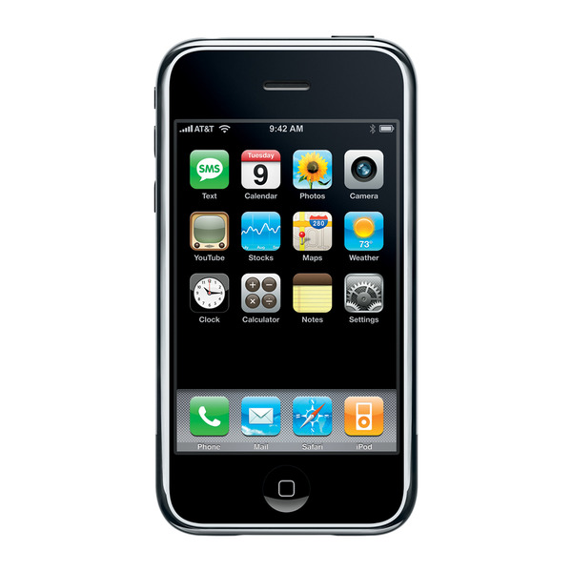
The Android Platform
Introduction
2007 : Apple transformed the telephone market with the iPhone :
  New Functionalities
  New Uses
  New Opportunities (Application market)
Difficulties for competitors…

Slide 7
The Android Platform
Introduction
End of 2007 : Open Handset Alliance creation
  Coalition to promote a new smartphone OS : Android
  34 IT companies at the creation
  84 today

Slide 8

The Android Platform
Open Handset Alliance

Slide 9
The Android Platform
Introduction
  Innovative : Integrates all the latest phone technology
    Touchscreen, GPS, Camera, Accelerometer, NFC…
  Accessible
    No need to buy specific Software or Hardware to develop
    Java is the most widely used language, no need to learn another little used language
  Open
    Open Source license : everyone can see the sources and working on it

Slide 10
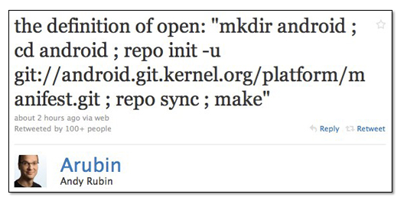
The Android Platform
Presentation
The definition of open according to Android chief Andy Rubin :
Notes:
http://android-france.fr/2010/10/21/open-source-andy-rubin-repond-a-sa-saintete-steve/

Slide 11
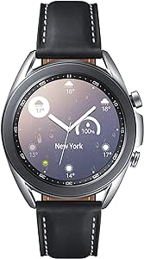
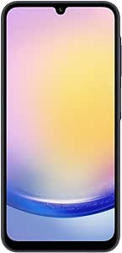
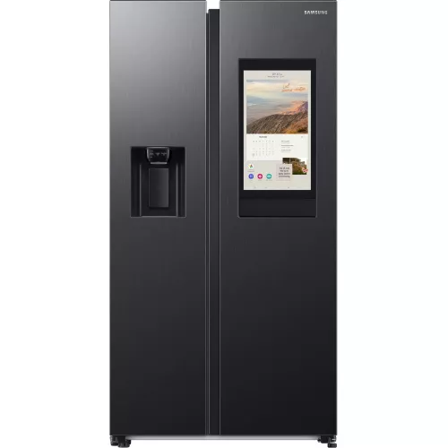
The Android Platform
Presentation
Android is designed for mobile devices in a broad sense :
  Phones
  Tablets
  Televisions
  Headphones
  Microwaves
  Watch
  …

Slide 12
The Android Platform
Presentation
Android is an operating system based on the Linux kernel
Developed by Android, Inc
  Acquired by Google in August 2005
  Brought to market by Google and the Open Handset Alliance
Open Source, licensed primarily under the Apache 2 License
  Linux kernel patches are GPLv2
Programming environment based on Java
  Using ART VM
    Before Android5 the VM was Dalvik

Slide 13
Versions
The Android Platform
Septembre 2008
Android 1.0
Février 2009
Android 1.1
Septembre 2009
1.6 : Donut
Mai 2010
2.2 : Froyo
2008
2009
2010
2011
Avril 2009
1.5 : Cupcake
Janvier 2010
2.1 : Eclair
Décembre 2010
2.3 : Gingerbread

Slide 14
Versions
The Android Platform
February 2011
3.0: Honeycomb
July 2011
Android 3.2
July 2012
4.1 : Jelly Bean
July 2013
Android 4.3
2011
2012
2013
2014
2015
May 2011
Android 3.1
Novembre 2011
4.0 : Ice Cream Sandwich
October 2013
4.4 : KitKat
November 2014
5.0 : Lollipop

Slide 15
Versions
The Android Platform
March 2015
5.1: Lollipop
October 2015
6.0: Marshmallow
August 2016
7.0 : Nougat
August 2017
8.0 Oreo
2015
2016
2017
2018
2019
March 2018
9.1 : Pie

Slide 16
Versions
The Android Platform
March 2019
10.0: Quince tart
September 2020
11.0 Red Velvet Cake
August 2021
12.0 :Snow cone
August 2022
13.0 Tiramisu
2019
2020
2021
2022
2023
October 2023
14.0 : Upside Down Cake

Slide 17
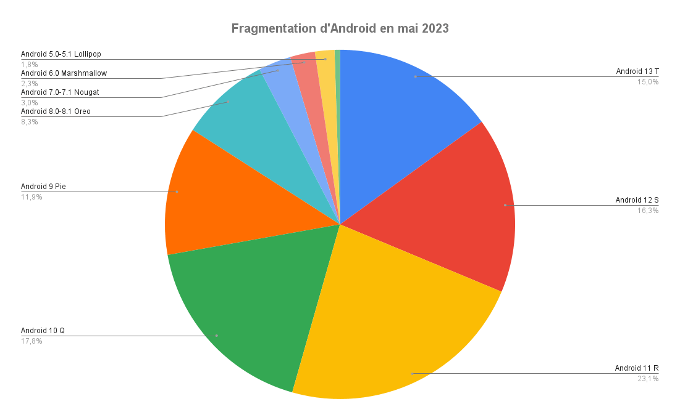
Android Fragmentations
The Android Platform
Version < Android 8.1 ➔ 7,6 %
Version >= 8.1 ➔ 92,4 %
Notes:
Update april 2024
https://developer.android.com/about/dashboards/index.html

Slide 18
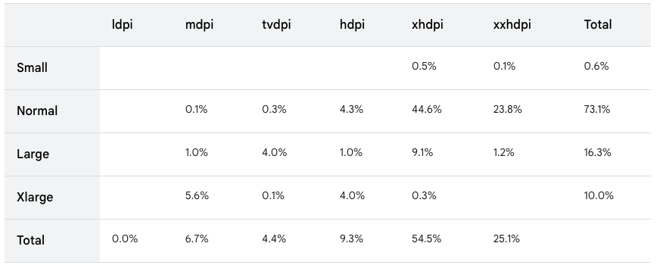
Display Fragmentations
The Android Platform
Notes:
Update April 2024
https://developer.android.com/about/dashboards/index.html

Slide 19
The Android Platform
Publishing Applications
Google Play
  Easy to publish, no approval process
  Trusted by consumers
  Low registration free
  Google takes 30% of revenue from commercial applications
Other markets
  A wide variety of alternative marketplaces
  “Unknown sources” must be enabled on the device to use them

Slide 20
The Android Platform
Android Development Challenges
All mobile devices share common limitations
  CPU, Memory, Battery
  Access camera sensor are differents
Developers must keep these in mind
Android offers specific challenges
  Many different version of Android
  Wide variety of devices
    Screen sizes, Different features (GPS, accelerometer, …)
Android APIs are written to help manage these challenges

Slide 21
The Android Platform
Screen Sizes
Density Identifier | Approximate Density
ldpi | 120dpi
mdpi | 160dpi
hdpi | 240dpi
xhdpi | 320dpi
xxhdpi | 480dpi
xxxhdpi | 640dpi

Slide 22
Questions ?

Slide 23

Discover tools
Android Preparation

Slide 24
Preview
Discover tools
Install JDK
Download all-in-One Bundle from https://developer.android.com/studio?hl=fr

Slide 25

Android Studio Bundle
Discover tools
Available on Windows, Mac OS X, Linux
  Contains
    Android Studio
    The Android Software Development Kit (SDK)
Used in order to develop Android Application
Contains the emulator, APIs and tools
Provided by Google

Slide 26
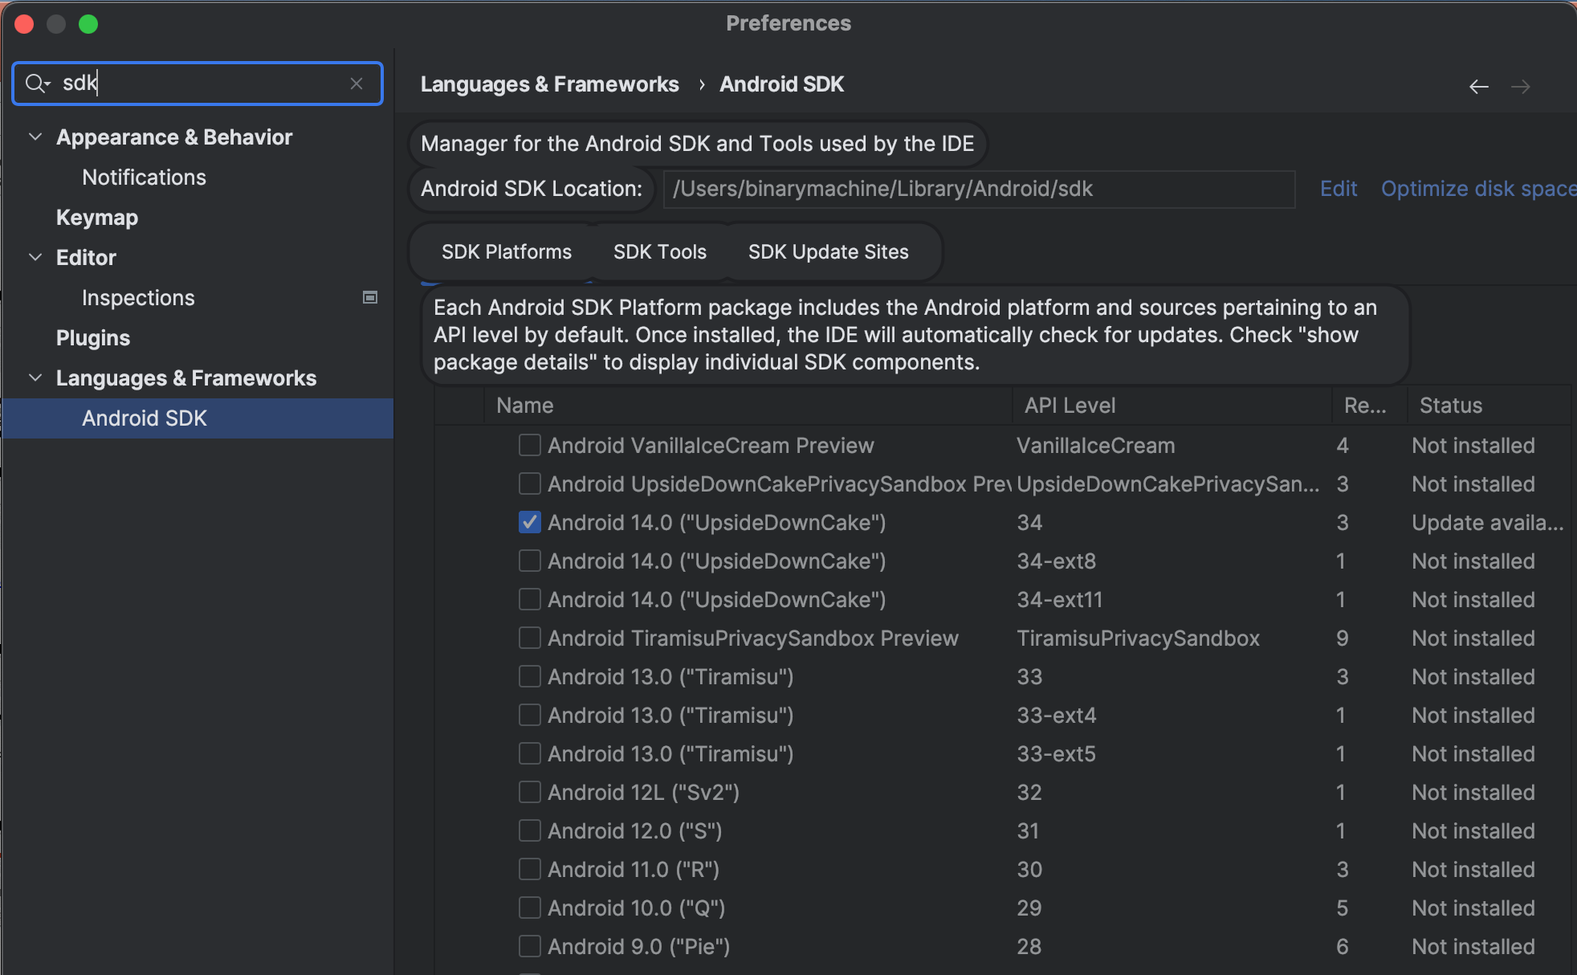
Android Studio Bundle
Discover tools
Android SDK Manager manages download of SDK versions
  Run from Android Studio

Slide 27
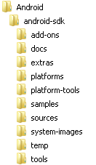
Android Studio Bundle
Discover tools
SQK has a standard stucture
Android SDK home directory
Vendor-specific API support
for each version (e.g., Google APIs)
API documentation
USB drivers, compatibility libraries, etc.
API support for each version
Debugging tools
API sample code
API source code
Virtual machine images
SDK tools

Slide 28
Android Studio
Discover tools
Run
Run configuration
Project view
Android Studio has powerful code-completion capabilities. Exercise timings assume that you will use them!
Gradle messages

Slide 29
Android Studio Bundle
Discover tools
Android SDK Manager manages download of SDK versions
  Run from Android Studio
  Download Android SDK27
    Choose android Oreo 8.0
    To be compatible with >90%
    of devices

Slide 30
Gradle
Discover tools
Android Studio uses Gradle for all build processes
Knowledge of Gradle is not required for Android development
  Android Studio provides preconfigured
  Build.gradle
Gradle is a project automation tool that builds upon the concepts of Apache Ant and Apache Maven
  Introduces a Groovy-based Domain-Specific Language (DSL) instead of the more traditional XML form of declaring the project configuration
Gradle was designed for multi-project builds that can grow to be large
  Supports incremental builds by intelligently determining which parts of the build tree are up-to-date

Slide 31
Emulator
Discover tools
The Android SDK provides an emulator
  Known as an Android Virtual Device (AVD)
Used to test applications under development
Allows multiple configurations to be created
  Different API versions and screen sizes
  Detailed configuration, such as memory size and GPS emulation, available
AVDs are managed by the AVD Manager

Slide 32
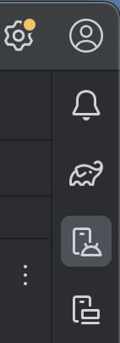
Creating Emulator
Discover tools
Start Android Studio
Select Tools | Device Manager
There is also a toolbar shortcut
Click Create Virtual Device
Select a Category of Phone
Select Pixel 8
Click Next
On the System Image screen,
  select Oreo
Click Next
Set the AVD Name to Google Pixel
Click Show Advanced Settings
Click Finish

Slide 33
Emulator
Discover tools
Android emulators are not perfect!
  They cannot emulate all hardware sensors
  The camera may not work with your PC camera
  They often have minor bugs!
  Which vary from version to version

Slide 34
Questions ?

Slide 35

The end
Thanks for your attention

